Slide 1

Addiction to social media and programmers' productivity
DONE BY
Rahaf Salman
&
Ibtihaj Adham

Slide 2

 | Problem definition The problem being addressed is social media addiction and its negative impact on programmers' productivity. This addiction can lead to work quality and productivity, and stresses the importance of maintaining a balance between work and personal life to maximize productivity.

Slide 3
research question
"How does social media addiction affect the productivity of programmers?" or
"What is the relationship between social media addiction and the productivity of programmers?"

Slide 4
hypotheses
1
High addiction to social media leads to low productivity among programmers. This hypothesis suggests that excessive use of social media platforms can distract programmers from their work and negatively impact their productivity.
2
Addiction to social media does not significantly impact programmers' productivity. This hypothesis suggests that social media addiction and programming productivity may be
NOTE
There are other hypotheses
That we discussed
in the report

Slide 5
01
02
Studies have shown that social media addiction can have a significant impact on programmer productivity. Here are some examples:
03
According to a study by the University of California, Irvine, it takes an average of 23 minutes and 15 seconds for programmers to return to their work after being interrupted by email, instant messages, or social media notifications.
A study by Udemy found that 36% of employees spend more than 2 hours a day on social media at work, and 70% of employees admit to checking social media while at work.
In a survey by CareerBuilder, 31% of hiring managers reported that they have passed on a candidate because of what they found on their social media profiles. This shows that social media addiction can impact job opportunities and career success.

Slide 6
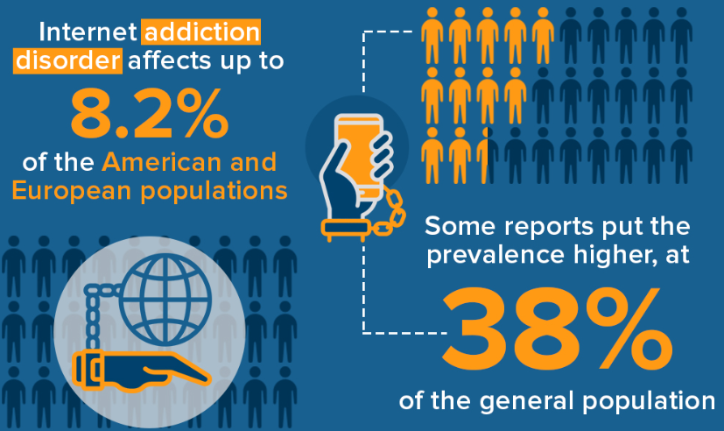
Crucial Technology Addiction Statistics: 2023 Data on Internet, Video Games & Social Media -

Slide 7
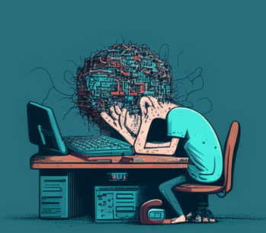
tips and strategies for overcoming social media addiction
1) Limit social media usage
2) Take regular breaks .
3) Set goals and deadlines
4) Use productivity apps

Slide 8

Methodology

Slide 9


Social media addiction can have a significant impact on mental health and well-being. Here are a few ways it can affect individuals

Slide 10
1) Anxiety and depression: Excessive social media use has been linked to increased levels of anxiety and depression. 2) Sleep disorders: Social media addiction can interfere with sleep patterns, making it difficult to fall asleep or stay asleep 3) Decreased self-esteem 4) Burnout: Social media addiction can lead to burnout, which is a state of emotional, physical, and mental exhaustion caused by prolonged exposure to stress.

Slide 11

Results:
Research suggests that addiction to social media can negatively impact productivity and work performance. Studies have found that excessive social media use can lead to distraction, decreased focus, and difficulty in maintaining concentration, which can all affect productivity. Moreover, social media addiction can also lead to increased stress, anxiety, and depression, which can further impact work performance
In the case of programmers:
the negative effects of social media addiction can be particularly detrimental as their work requires a high level of focus, attention to detail, and concentration. Additionally, frequent interruptions can disrupt the flow of programming tasks and lead to increased errors and delays.

Slide 12
Solution recommendations
To address this issue, it is recommended that programmers limit their social media use during work hours and take regular breaks to refresh their minds. They can also use productivity tools and techniques to increase focus and concentration. Additionally, employers can also implement policies and guidelines to restrict social media use during work hours and provide resources and support for employees struggling with addiction to social media.

